Slide 1
COMP23420 week 11:
GoF Design Patterns
John Sargeant
johns@cs.man.ac.uk

Slide 2
What are Design Patterns?
Reusable designs, which can be used in different situations.
Have names with agreed meanings – used for communication between software developers.
Encapsulate best practice - “new design pattern” is an oxymoron.
Popularised by the “Gang of Four”, Gamma, Helm, Johnson & Vlissides – describes 23 patterns in detail.
Larman “Applying UML and patterns” is a gentler and broader into, especially chapter 26.

Slide 3
Building on GRASP
More specific, and more complex, than GRASP patterns.
Design solutions to typical recurring problems, rather than general principles.
Build on GRASP principles, especially polymorphism and indirection.
Generally applied to protect against variation.

Slide 4
Example patterns (1)
Adapter – plug together components with incompatible interfaces via an intermediate Adapter object.
(Simple) Factory – create objects indirectly via a separate Factory object, to decouple object creation from the code using the objects.
Singleton – ensure that only one instance of a class can be created – e.g. Factories are usually Singletons.

Slide 5
Example patterns (2)
Strategy – encapsulate an algorithm in an objects, so algorithms can be pluggable at runtime.
Composite – treat atomic and composite entities uniformly, giving a tree structure of objects with a common interface. (NB. Used with Strategy in Larman, but more often used on its own).
Observer – provide a flexible interface between Observables with some behaviour and Observers who want to monitor that behaviour.

Slide 6
Composite: Overview
A way of dealing with any tree structure, of any shape and depth
Applicable to many situations, e.g. exam questions, physical parts, documents.
An example is the structure of questions in the ABC (Assess by Computer) CAA system (started 2002)
There are plenty of other examples (iff you know the pattern)
My favourite design pattern!

Slide 7
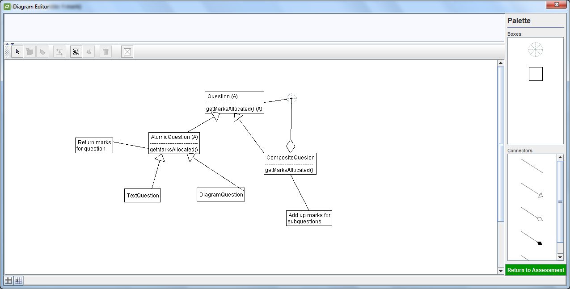
Composite: ABC example

Slide 8
Composite: consequences
The key is the dual relationship between Question and CompositeQuestion
Allows questions to be nested to any depth (like a traditional exam)
The leaves of the tree are atomic questions (text, diagrams, MCQs etc).
To get the marks for a composite question, recursively add up the marks for the subquestions.
Almost all CAA systems don’t do this, and have a flat list of questions.

Slide 9
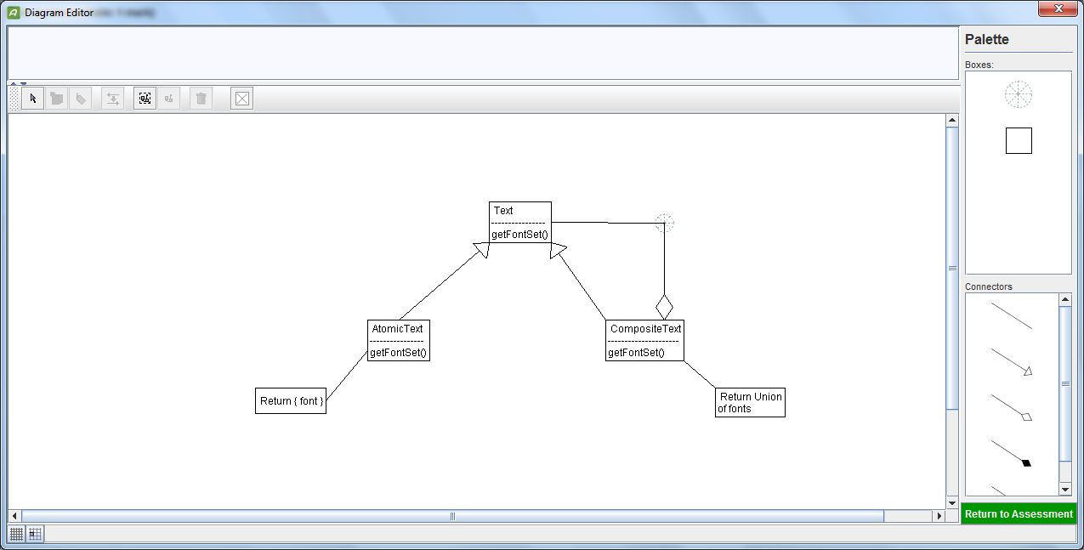
Font set example

Slide 10
Composite: variations
We may have just one kind of atomic thing (as here, a piece of text in just one font is treated as atomic).
Less commonly, we may have multiple kinds of composite things.
We may place limits on the depth of the tree and/or what can go where in the leaves.
The underlying structure is simple, representing it on a screen may be complex (e.g. in ABC, several different question layouts).

Slide 11
Observer: overview
We have objects whose state changes – observables
and objects which need to react to those state changes – observers.
We need to flexibly associate observers with observables, at runtime.
Example: In a Java Swing UI, JButtons, JMenuItems etc. are observables
Application code objects are observers.
Both implement interfaces (AbstractButton defines AddActionListener, ActionListener defines ActionPerformed)

Slide 12
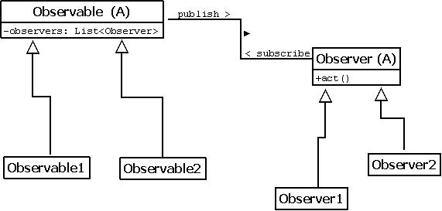
Observer pattern

Slide 13
Example
A security system for a large building has devices (beams, door alarms, CCTV etc.) and monitoring stations.
The allocation of devices to monitoring stations must be dynamic. When the building is busy, there are several monitoring stations in use, at night just one.
A device may be monitored at more than one station – e.g. a local station on the same floor and the central control room.
Monitoring stations may also be physically remote from the building.

Slide 14
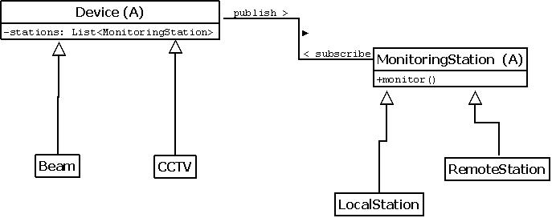
Solution with observer

Slide 15
Publish and Subscribe()
Observer is often described as publish-subscribe, but this is inaccurate for two reasons:
An observer has to subscribe (be added to a list in the observable) before it can be published to.
A third action then need to happen – the observer needs to act on the published information.
Also note that both subscribe() and publish() happen in the observable.
So a correct description is subscribe – publish - act

Slide 16
Consequences
A device may be monitored by any number of stations, simply by adding stations to the list (and removing them as required).
Devices see the same interface for all monitoring stations, and vice-versa, although concrete device classes will have different behaviour.
We can easily add new kinds of device or monitoring station (polymorphism/protected variations).
We can combine the use of Observer with other patterns, e.g. we can use Composite to group devices together into device groups.

Slide 17
Conclusion
Design patterns are crucial to good OO development.
The GoF book covers most, only a few have been recognised since.
They are not obvious – you need to know them, or at least where to find out.
They build on GRASP principles, which are even more fundamental.
To be a competent SW developer, you need to know GRASP principles (or equivalent) and at least some design patterns.

Slide 18

Questions?

